Slide 1
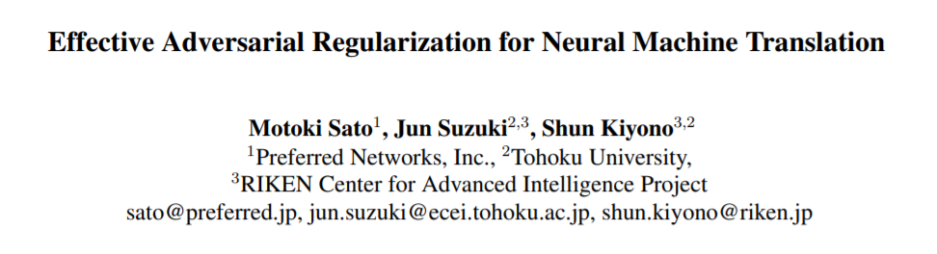
ACL 2019
Notes:
机器翻译上的对抗训练，把这个方法叫做对抗正则化

Slide 2
Outline
Introduction
Definitions & Notations
AdvT and VAT
Experiments

Slide 3
Introduction
Adversarial examples and adversarial training were first discovered and discussed in the field of image processing.
In the field of NLP, the input is a sequence of discrete symbols and it’s unreasonable to add a small perturbation.
The key idea of recent method is to apply adversarial permutations into the embedding layer, instead of the inputs.
Notes:
对抗样本和对抗训练最初是用在图像处理上的
在NLP领域，由于输入序列是离散的符号，很难在上面进行微小的扰动
最近的一些方法，把扰动加在embedding词向量上，而不是输入

Slide 4
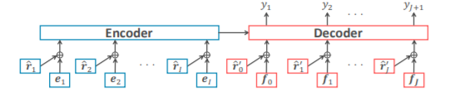
Introduction
Do not generate adversarial examples.
Refer to this technique as regularization technique – adversarial regularization.
Apply it on LSTM-based and Transformer-based NMT models.
Notes:
所以他不会生成对抗样本
把扰动加在embedding词向量上进行对抗攻击和训练，可以看作一种正则化方法
用在了LSTM和Transformer的模型上

Slide 5
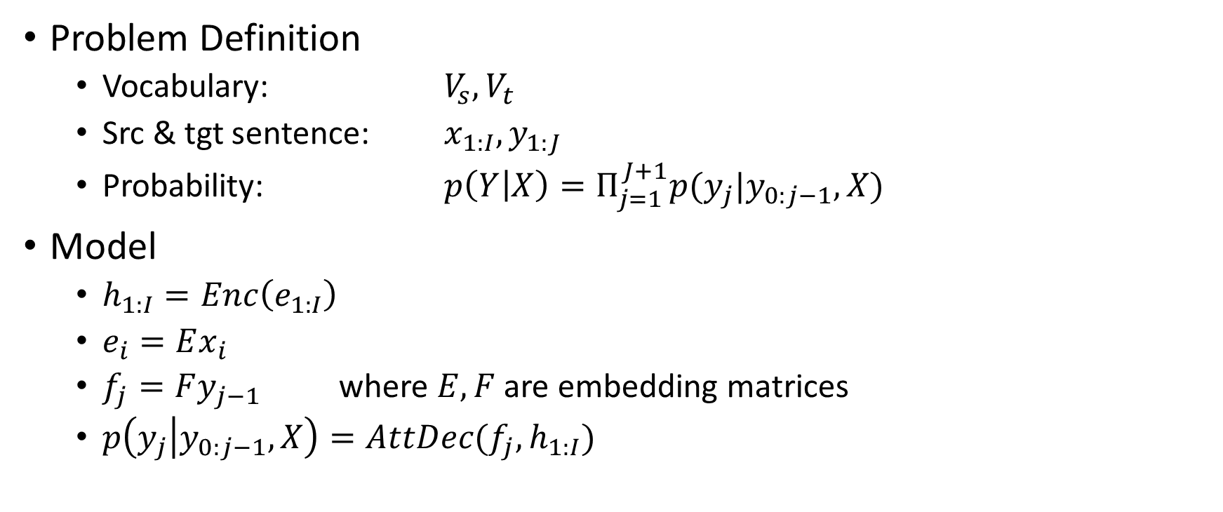
Notations
Problem Definition
Vocabulary: $V_{s}, V_{t}$
Src & tgt sentence: $x_{1:I}, y_{1:J}$
Probability: $p\left(Y | X\right)=Π_{j=1}^{J+1}p(y_{j}|y_{0:j−1},X)$
Model
$h_{1:I}=Enc\left(e_{1:I}\right)$
$e_{i}=Ex_{i}$
$f_{j}=Fy_{j−1}$ where $E, F$ are embedding matrices
$p\left(y_{j} | y_{0:j−1},X\right)=AttDec(f_{j},h_{1:I})$
Notes:
y_0 BOS，y_j+1 是 EOS

Slide 6
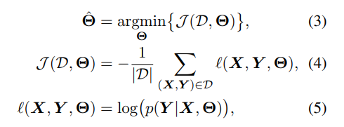
Notations
Training Loss:
Generation Strategy: K-beam search
Notes:
实际上做的是对抗训练，可以看作一种正则化方法

Slide 7
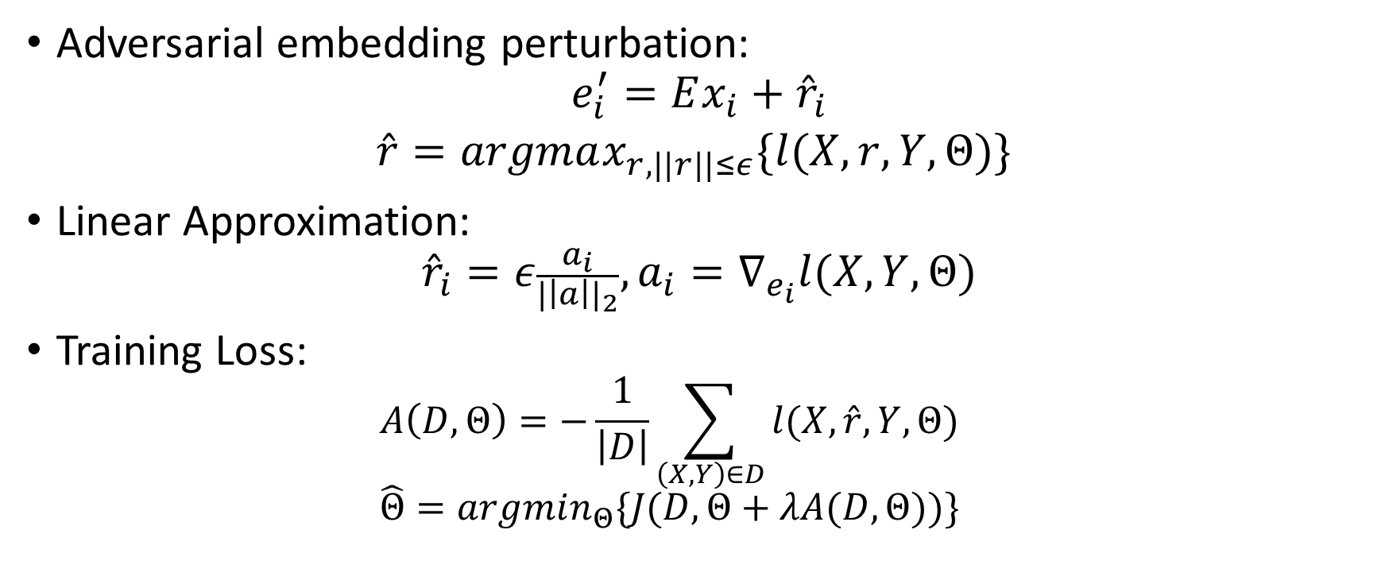
Adversarial Training
Adversarial embedding perturbation:
$$e_{i}^{′}=Ex_{i}+{\hat{r}}_{i}$$
$$\hat{r}=argmax_{r, ||r||≤ε}\{l(X,r,Y,Θ)\}$$
Linear Approximation:
$${\hat{r}}_{i}=ε\frac{a_{i}}{{|\left|a\right||}_{2}}, a_{i}=∇_{e_{i}}l(X,Y,Θ)$$
Training Loss:
$$A\left(D,Θ\right)=−\frac{1}{\left|D\right|}\sum_{\left(X,Y\right)∈D}{l(X,\hat{r},Y,Θ)}$$
$$\hat{Θ}=argmin_{Θ}\{J(D,Θ+λA(D,Θ))\}$$
Notes:
用的第一个方法
It is generally infeasible to exactly estimate r_hat, linear approximation.
\epsilon and \lambda are hyper-parameters.

Slide 8
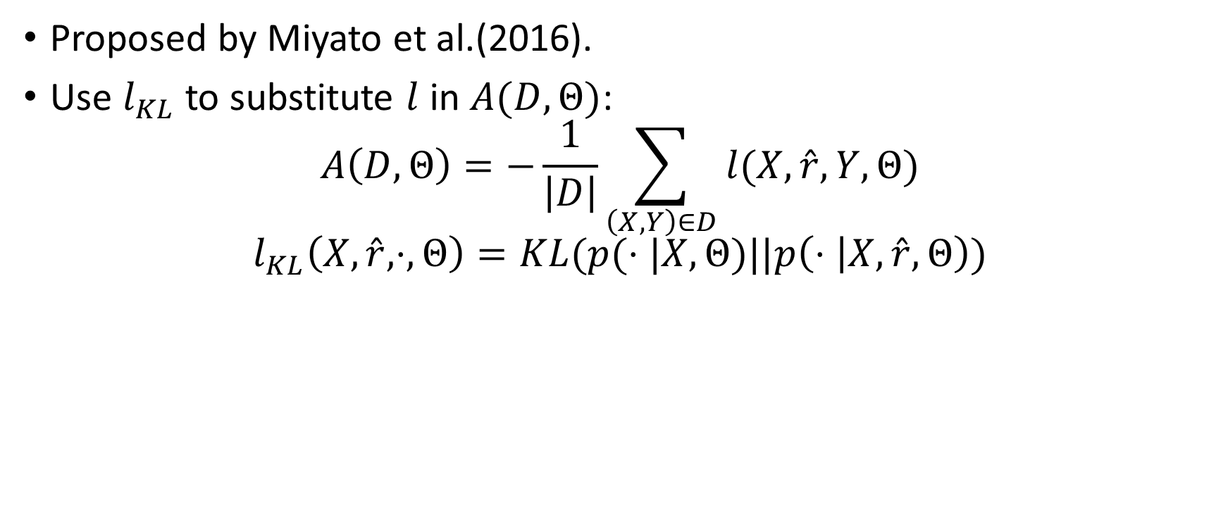
Virtual Adversarial Training
Proposed by Miyato et al.(2016).
Use $l_{KL}$ to substitute $l$ in $A(D,Θ)$:
$$A\left(D,Θ\right)=−\frac{1}{\left|D\right|}\sum_{\left(X,Y\right)∈D}{l(X,\hat{r},Y,Θ)}$$
$$l_{KL}\left(X,\hat{r},⋅,Θ\right)=KL(p(⋅|X,Θ)||p\left(⋅ | X,\hat{r},Θ\right))$$
Notes:
mainly used for the semi-supervised extension of the adversarial regularization technique
替换了扰动之后的loss，用扰动前后的概率分布的KL散度

Slide 9

Experiments
Base models: LSTM, Transformer
Regularization Object:
Source emb
Target emb
Source and Target emb
Regularization technique:
AdvT (Adversarial Training)
VAT (Virtual Adversarial Training)
Hyperparameters: $λ=1,ε=1$

Slide 10
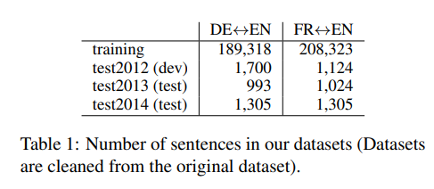
Results on IWSLT
Notes:
Enc-dec is better than only one permutation place.
Enc is better than dec.

Slide 11
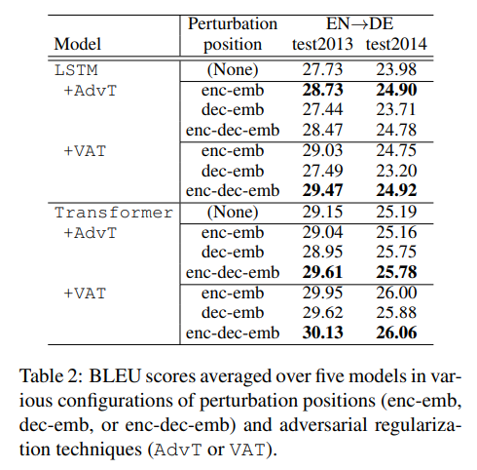
Results on IWSLT
Enc-dec is better than enc or dec only.
Enc is better than dec.
The results of VAT is better than AdvT.
AdvT is exposed to true labels
and tend to overfit.

Slide 12
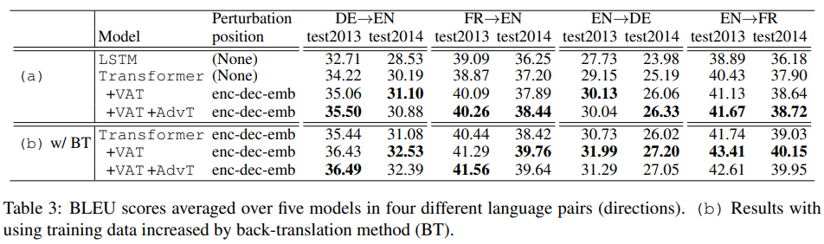
Results on four language pairs
BT is trained with generated data using back-translation.

Slide 13
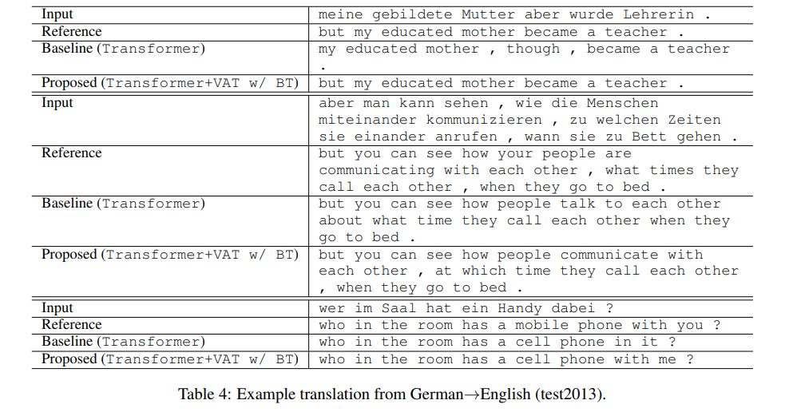
Results on four language pairs

Slide 14
Conclusion
Applying VAT to both encoder and decoder embeddings outperforms original models.
Adversarial regularization still works when we perform it with training data increased by a back-translation method.
Adv regularization can be a common technology to improve translation quality, just as model ensample, BPE and back-translation.
Notes:
没有生成对抗样本的攻击，意义小很多，对词替换无效
可以增加模型的鲁棒性，所以被称作对抗正则化，如果有loss的分析体现正则化效果更好

Slide 15
Thanks.

